Slide 1
Live Session 4
By Ben Goodwin

Slide 2
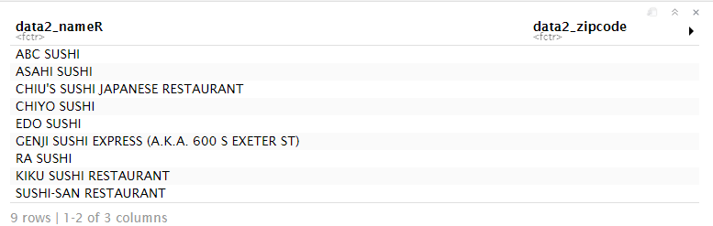
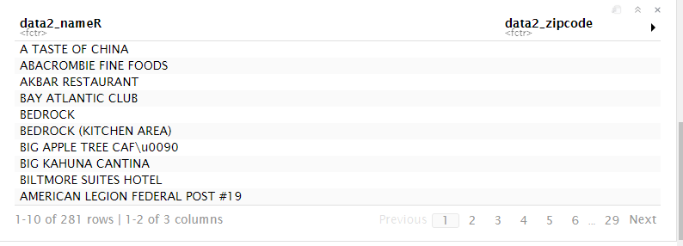
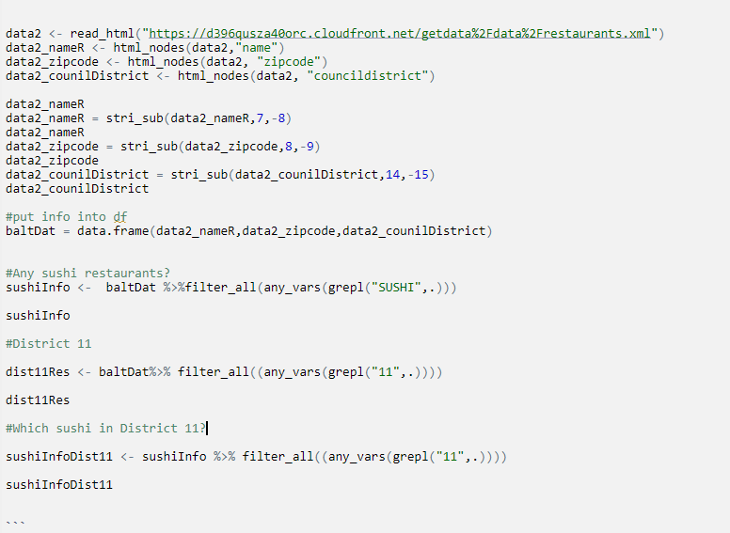
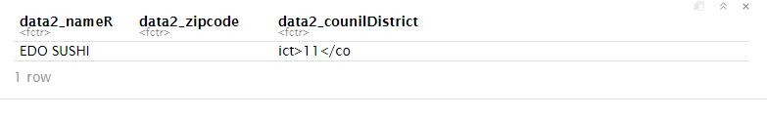
Part 1, Restaurant data from Baltimore (Are there any Sushi restaurants in Baltimore?)
Yes-From the data, we can see there are 9 restaurants in Baltimore that contain the word “SUSHI.”
R Output
Sushi Restaurants
R input
Downtown Restaurants
Sushi Downtown
The data contained: 9 Sushi Restaurants, 281 downtown restaurants, and 1 downtown sushi restaurant.

Slide 3
Council District Restaurant Count

